Slide 1
Soft Skill
Present by : Vasu Bhut
Guidance By : Manvi Mam

Slide 2
INTRODUCTION
My Name is Vasu Bhut.
I am Recently I have completed my graduation in B.C.A from atmiya university. Also I have pursuing certification in Java Developer from Tops Technologies.
I am from Junagadh and we are 5 member in family.
Hobbies : Travelling, Cricket

Slide 3

Why are you into IT field?
Many opportunities
Remote work flexibility
Growth
Safe future
Work-life balance

Slide 4
where do you see yourself after 5 years
Senior Java Developer
Java Architect
Team Lead
Java Expert
Freelance Consultant

Slide 5
strengths
weaknesses
Honest
Positive attitude
Flexible
Team Player
Problem Solver
Self-critical
Insecure
Competitive
Sensitive
Uncomfortable with public speaking

Slide 6
What Inspires You
Flexible hours or the ability to work from home
A positive and supportive team environment
Compensation and benefits that are competitive and fair
Job Security and Financial Rewards

Slide 7

Short-term goals
Change your job
Create a website
Creating a portfolio
Start a personal project

Slide 8
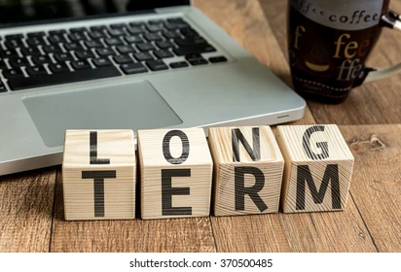
Long-term goals
Get your dream job
Increase your salary
Focus on Fitness
Change careers

Slide 9
Thank You

